Slide 1
Explainable AI in Medical Diagnosis
Submitted in the partial fulfillment for the award of the degree of
BACHELOR OF ENGINEERING
IN
Artificial Intelligence and Machine Learning
Submitted by :
Aryan Sharma 21BCS5820
Sonika Sharma 21BCS8269
Under the Supervision of:
Ms. Monica Luthra
Department of AIT-CSE
DISCOVER . LEARN . EMPOWER

Slide 2
Outline
Introduction
Problem Formulation
Objectives
Methodology
Existing Solution
Proposed Solution
Results and Outputs
Conclusion
Future Scope
References

Slide 3
Introduction
Many AI models used in medicine are complex and difficult to understand, hindering trust and adoption.
Explainable AI (XAI) makes AI models understandable, increasing trust, aiding clinical decision-making, and ensuring regulatory compliance.
XAI can help doctors validate or challenge AI-generated diagnoses, leading to improved accuracy and patient outcomes.
Understanding the reasoning behind a diagnosis increases patient confidence and engagement in their healthcare.
XAI can help identify biases in AI models, ensuring fair and equitable healthcare for all patients.

Slide 4
Problem Formulation
Lack of transparency in AI Models : Traditional AI models in medical diagnosis operate as “black boxes,” providing no clear understanding of how they arrive at a decision, which makes it difficult for healthcare professionals to trust and rely on them.
Need for Trust and Accountability : We are using EHR and EMR database to make it more secure and trust will be built
Interpretability for Clinicians : AI models must provide explanations that are easily understood by healthcare providers.
Ethical and Regulatory Compliance : Explainable AI is necessary to meet ethical and regulatory requirements, such as GDPR, ensuring that AI systems in healthcare maintain data privacy and responsible decision-making.

Slide 5
Objectives
Determine the current progress within the different infection/diseases based on AI algorithms and their respective configurations.
To make it to the rural areas because of lack of facilities there.
Discuss the future of medical XAI, supported by explanation measures by human-in-the-loop process in the XAI based systems with case studies.
Demonstrate a novel XAI Recommendation System and XAI Scoring System applicable to multiple fields.

Slide 6
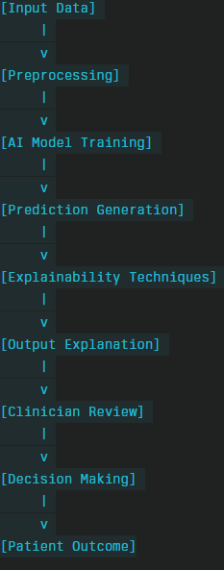
Methodology
Input data : Patient Data
Preprocessing: Data cleaning, Data Normalization and Feature Extraction
AI model training: Model Selection and training
Prediction Generation: Generate Diagnosis
Explainability techniques: SHAP for interpretability.
Generate heatmaps for feature importance scores.
Output Explanation: Visual and Textual
Clinical review: UI/UX
Decision Making: Doctor’s feedback
Patient outcome: Complete explanation of diagnosis and treatment for the same

Slide 7
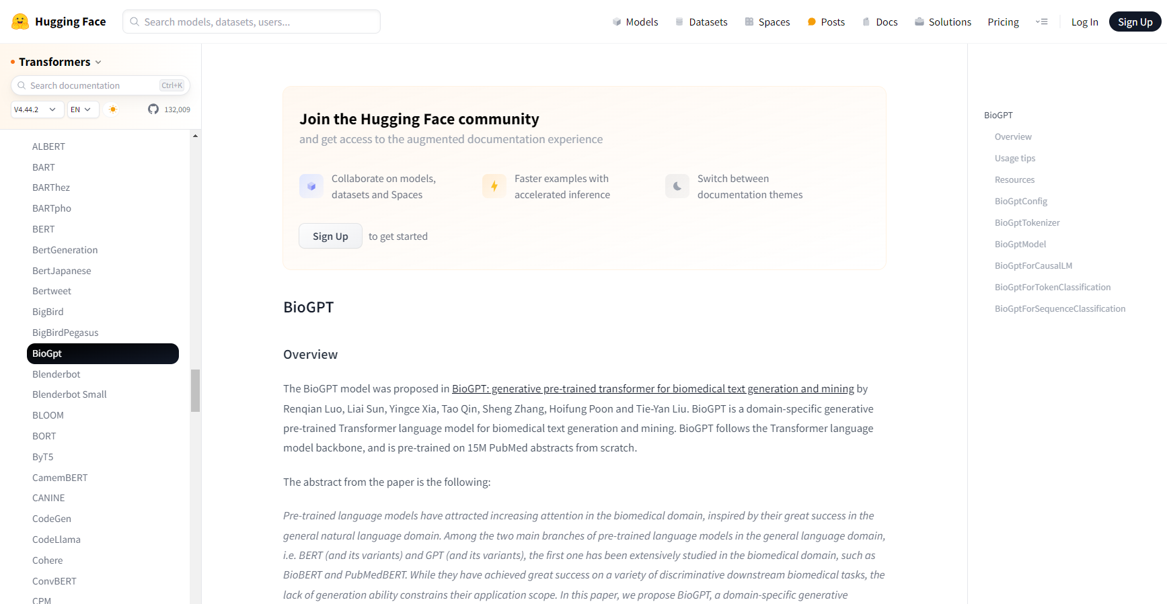
Existing Solution
BioGPT is a language model designed for processing and understanding biomedical literature, enabling tasks like text generation, information extraction, and knowledge discovery in the biomedical domain. It helps researchers and practitioners quickly gather insights from vast amounts of medical and biological texts.

Slide 8




Proposed Solution
SCAN
UPLOAD
CHATBOT
HISTORY

Slide 9

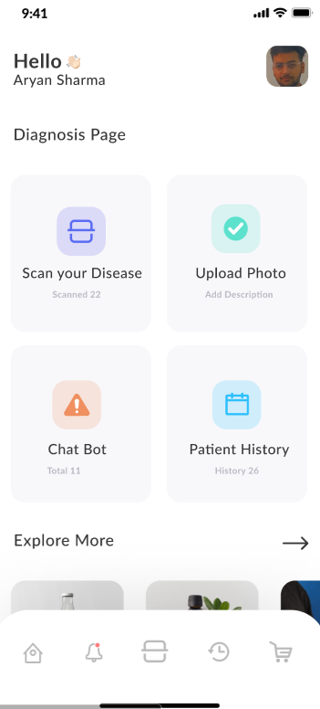

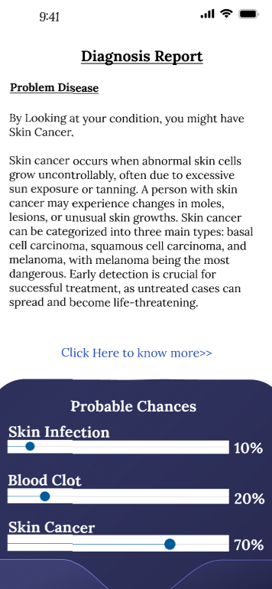
Results and Outputs

Slide 10
Conclusion
Enhanced Trust: Explainable AI (XAI) fosters trust among healthcare professionals and patients by providing transparent insights into AI decision-making processes.
Improved Clinical Outcomes: By clarifying the rationale behind AI-generated recommendations, XAI enhances clinical decision-making, leading to more accurate diagnoses and better patient outcomes.
Ethical Compliance: XAI addresses ethical concerns related to accountability and bias, ensuring that AI systems adhere to regulatory standards and promote equitable healthcare practices.
Interdisciplinary Collaboration: The development of XAI encourages collaboration between data scientists, clinicians, and ethicists, fostering innovation in healthcare technology.
Future Potential: Continued advancements in XAI methodologies hold significant promise for revolutionizing medical diagnosis, ultimately enhancing the quality of care delivered to patients.

Slide 11
Future Scope
Concept based explanation: Instead of just highlighting important features, these methods explain diagnoses in terms of high-level medical concepts that doctors are familiar with.
Multimodal explanations: Combining different types of medical data (e.g., imaging, lab results, and patient history) to provide more comprehensive explanations that mirror the way doctors think about diagnoses.
Causal AI: Emerging causal inference techniques aim to move beyond correlation to explain potential cause-and-effect relationships in diagnoses, which is crucial for medical understanding.
Counterfactual explanations with actionable insights: Advanced counterfactual methods that not only show how different inputs would change the diagnosis but also suggest potential treatments or interventions.

Slide 12
References
[1]. Basu, S., et al. (2020). Applications of artificial intelligence in emergency and critical care. Frontiers in Artificial Intelligence. Link
[2]. Kumar, A., et al. (2023). AI and ML in critical care diagnostics: Revolutionizing healthcare. Journal of Critical Care Medicine.
[3]. Sengupta, S., et al. (2024). New AI model draws treasure maps to diagnose disease. Beckman Institute. Link
[4]. Anwar, S., et al. (2021). An Explainable AI Framework for Artificial Intelligence of Medical Things. arXiv preprint. Link
[5]. Hinton, G., et al. (2022). Revolutionizing healthcare: The role of artificial intelligence in clinical practice. BMC Medical Education. Link

Slide 13
Thank You!
Q & A

